Slide 1

Week 11 : SOFTWARE DEVELOPMENT TOOLS AND ENVIRONMENTS

Slide 2
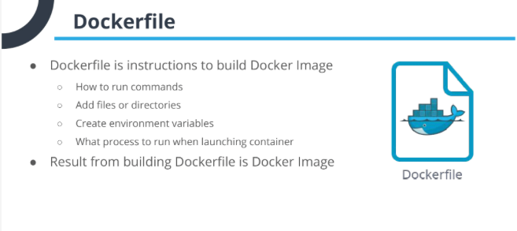

Slide 3
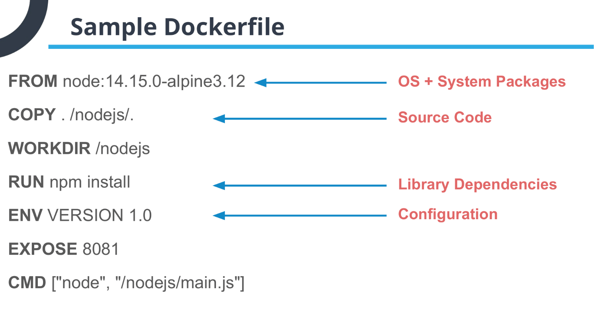

Slide 4
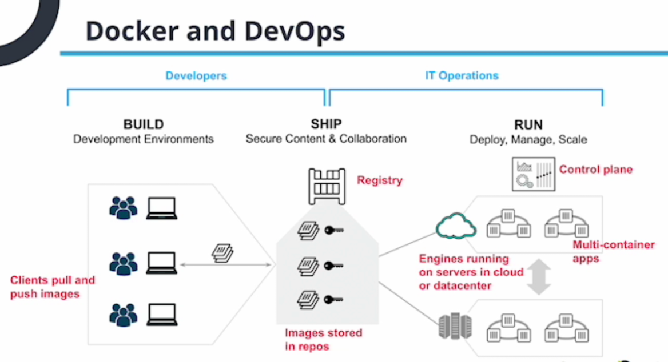

Slide 5
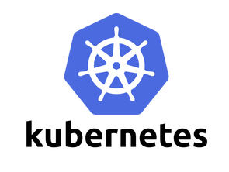

Introduction to Kubernetes

Slide 6
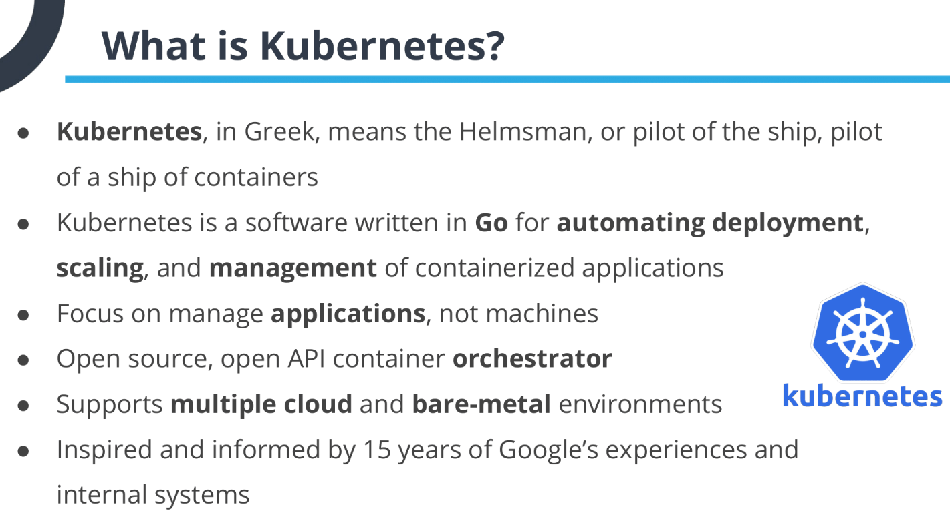

Slide 7
The Why's and What's of Kubernetes

Slide 8
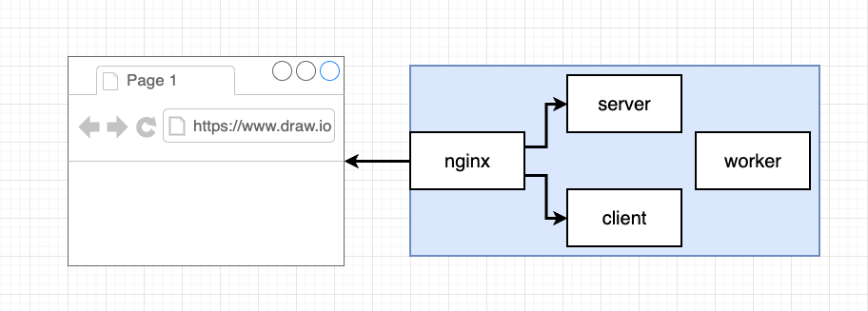

Slide 9
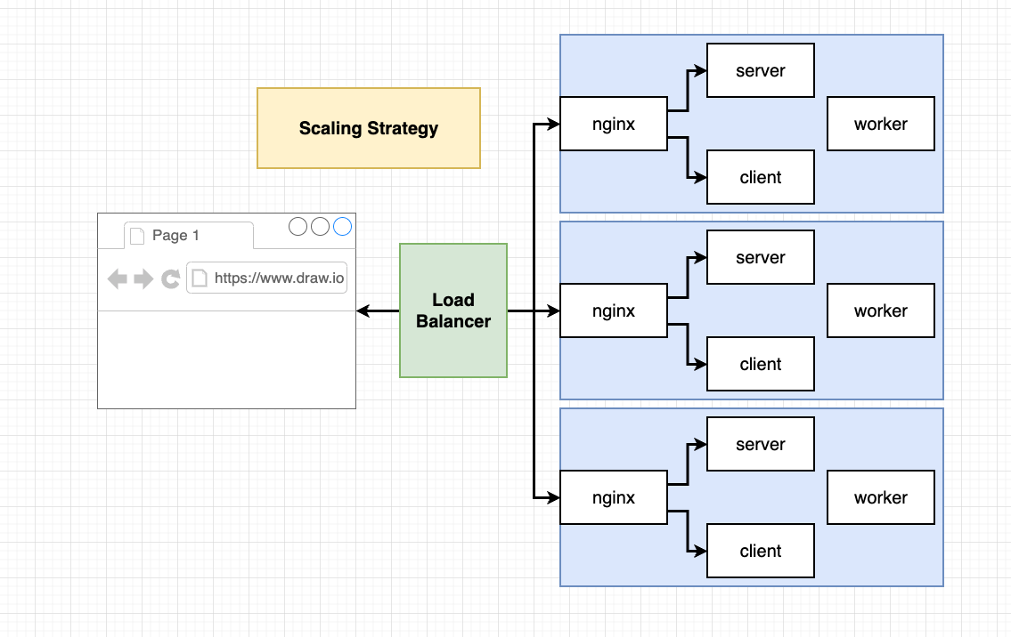

Slide 10
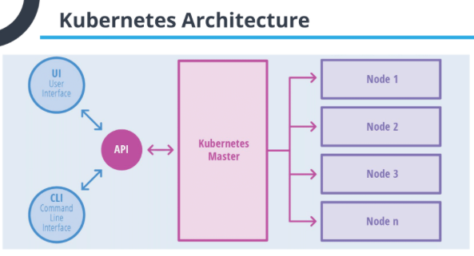

Slide 11
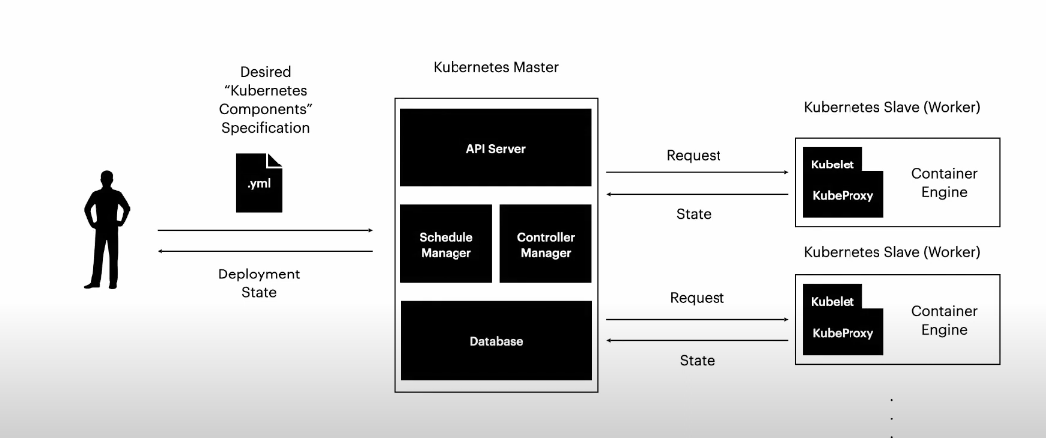

Slide 12
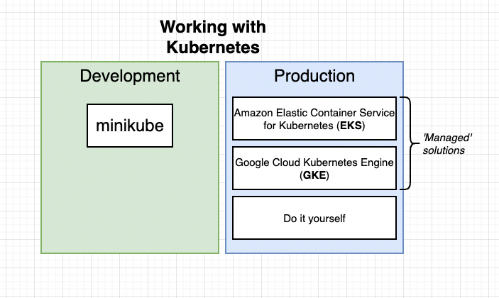
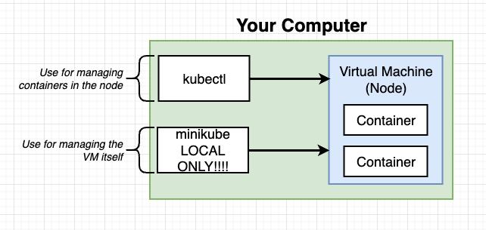

Slide 13
Concept of pods replica and deployments

Slide 14
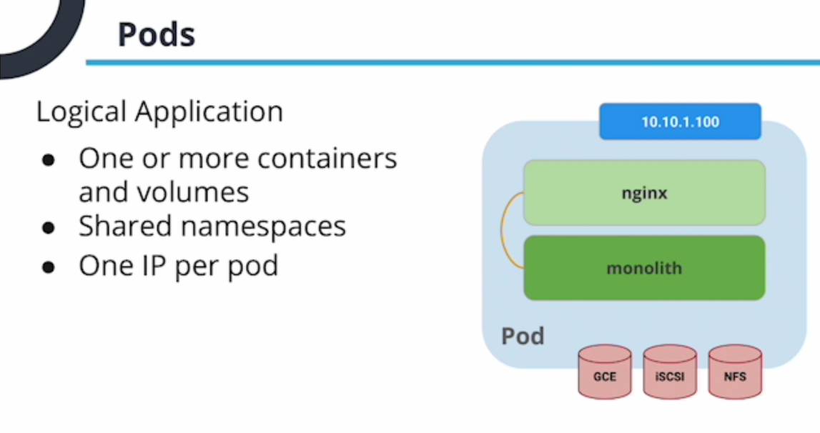
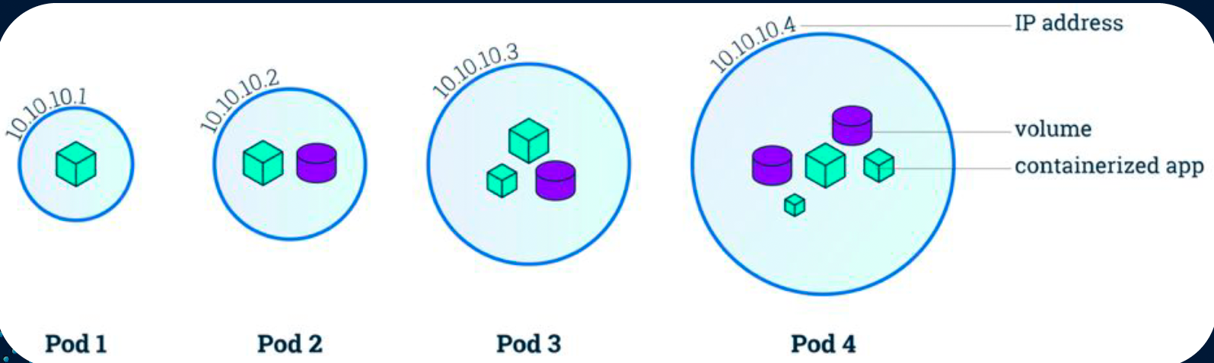

Slide 15
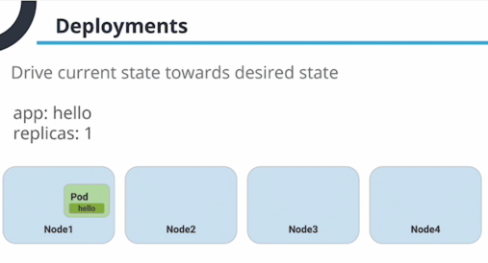
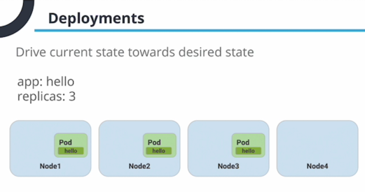
Deployment and replica

Slide 16
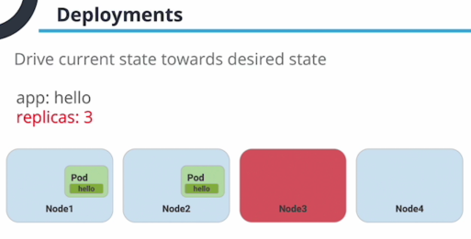
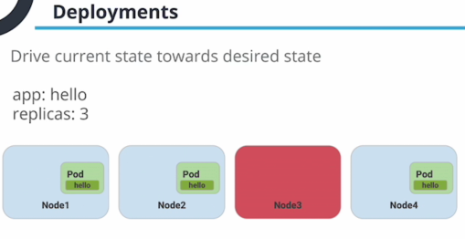
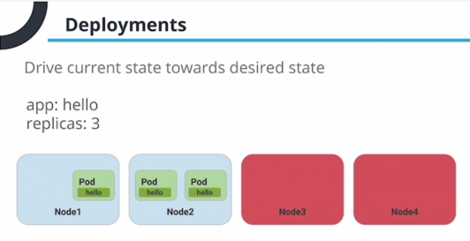
Dead 1 Node
Sol :Dead 1 Node

Slide 17
Pod
https://kubernetes.io/docs/concepts/workloads/pods/
Replicas set
https://kubernetes.io/docs/concepts/workloads/controllers/replicaset/
Deployment
https://kubernetes.io/docs/concepts/workloads/controllers/deployment/

Slide 18
Basic Command

Slide 19
Kubernetes Basic Command (get) : kubectl get {object} –n {namespace}
kubectl get pod –n kube-system
kubectl get replicaset –n kube-system
kubectl get deployment –n kube-system

Slide 20
Kubernetes Basic Command (describe): kubectl describe {object} {pod name} –n {namespace}
kubectl describe pod {pod name} –n kube-system
kubectl describe replicaset {replicaset name} –n kube-system
kubectl describe deployment {deplotment name} –n kube-system

Slide 21
Kubernetes Basic Command (log) : kubectl logs {pod name} –n {namespace}
kubectl logs pod {pod name} –n kube-system

Slide 22
Kubernetes Basic Command (log) : kubectl exec -it {pod name} –n {namespace} -- sh/bash
kubectl exec -it {pod name} –n {namespace} -- sh/bash

Slide 23
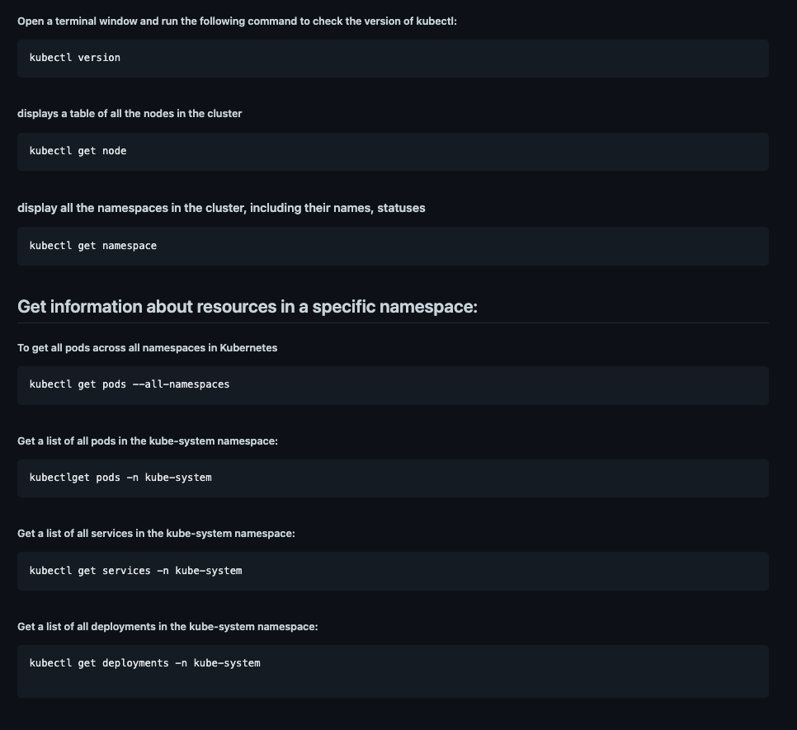
LAB basic-command
https://github.com/Tuchsanai/SOFTWARE-DEVELOPMENT-TOOLS-AND-ENVIRONMENTS/tree/main/Week11/basic-command

Slide 24
Pod

Slide 25
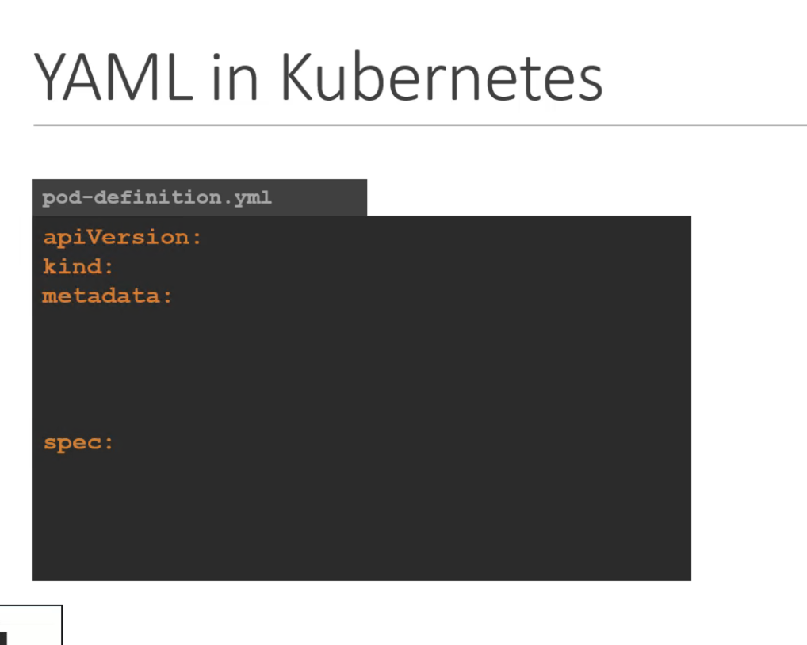

Slide 26
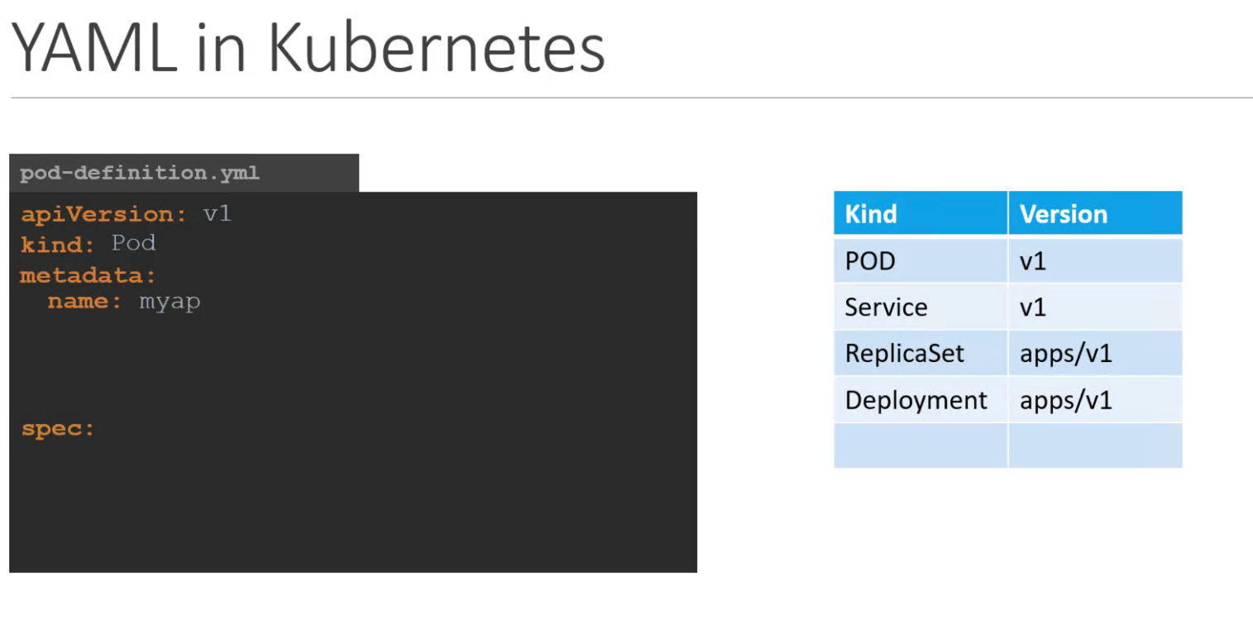

Slide 27
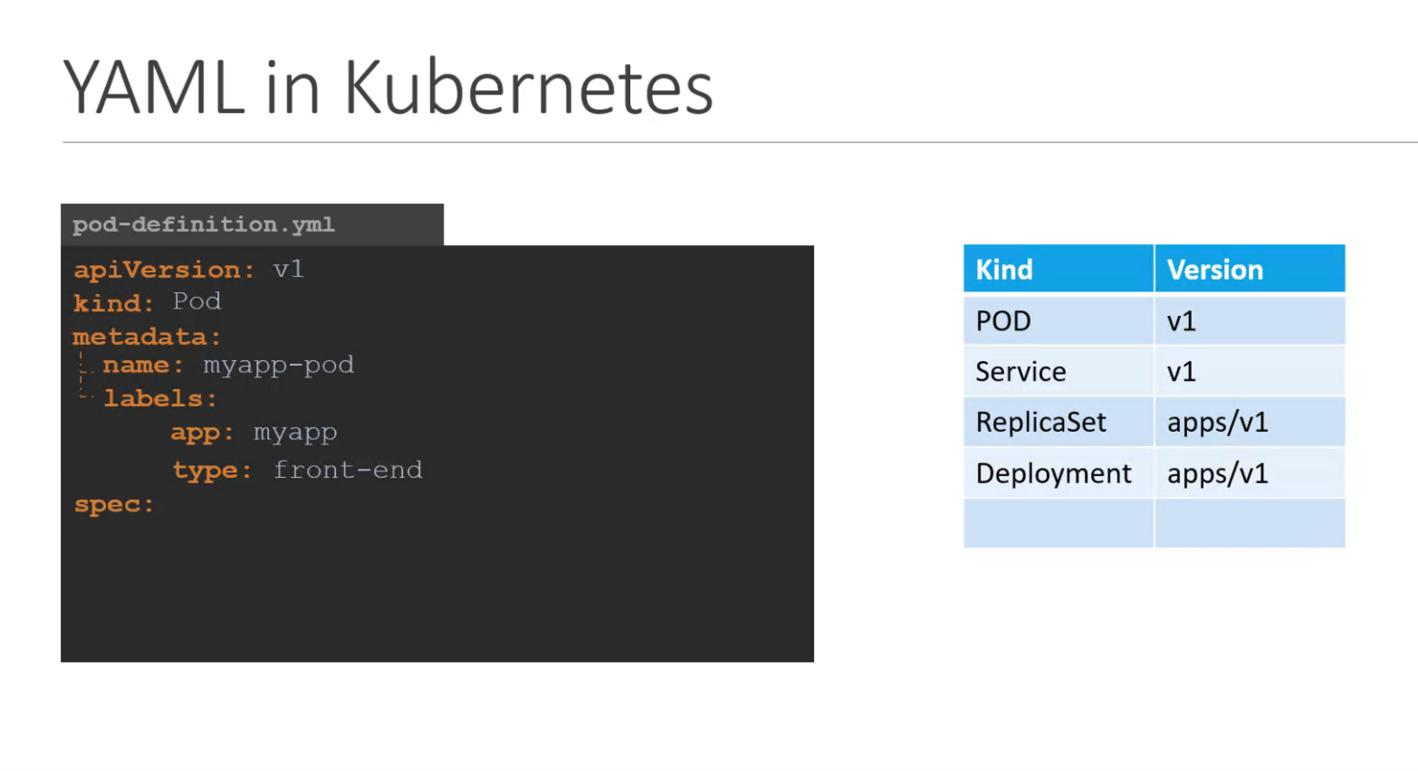

Slide 28
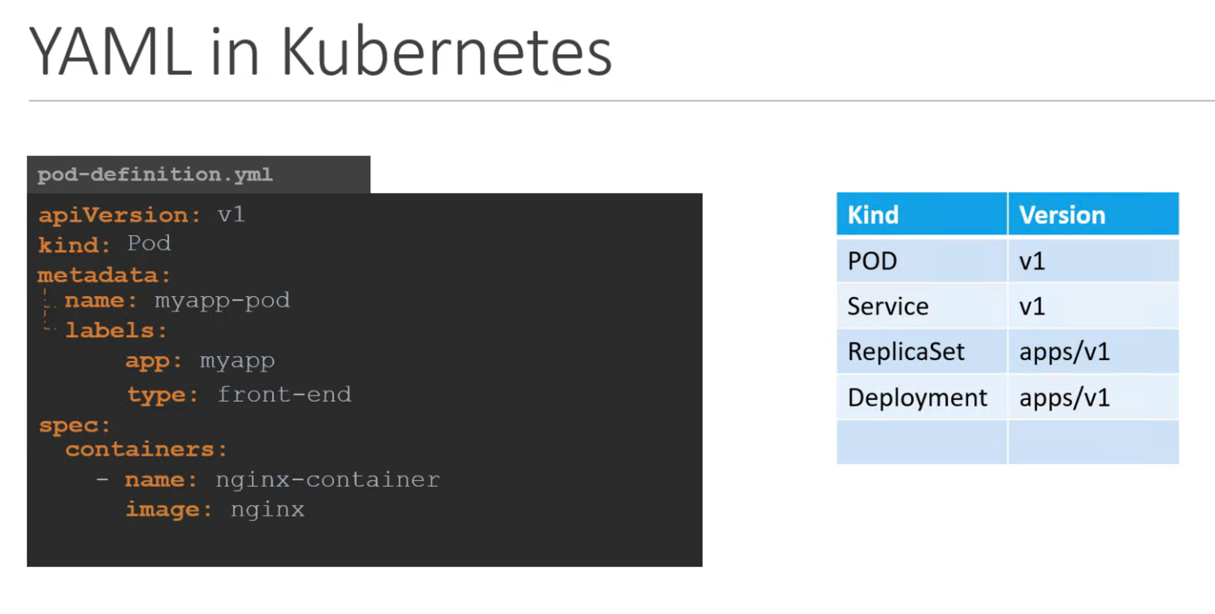

Slide 29
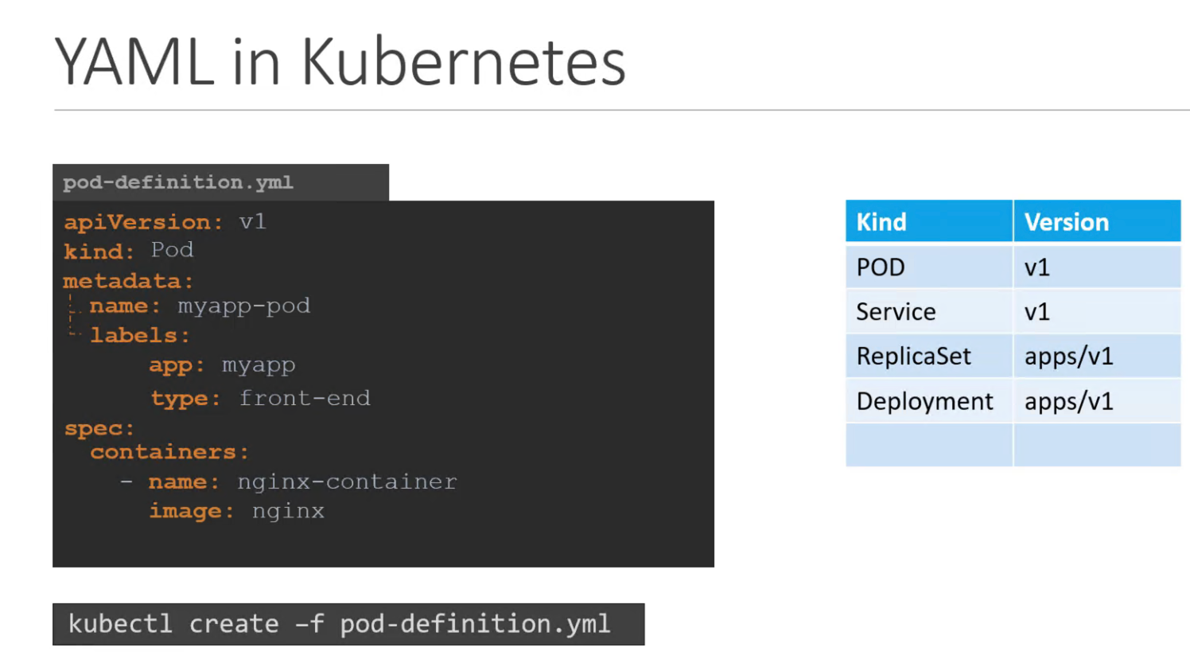

Slide 30
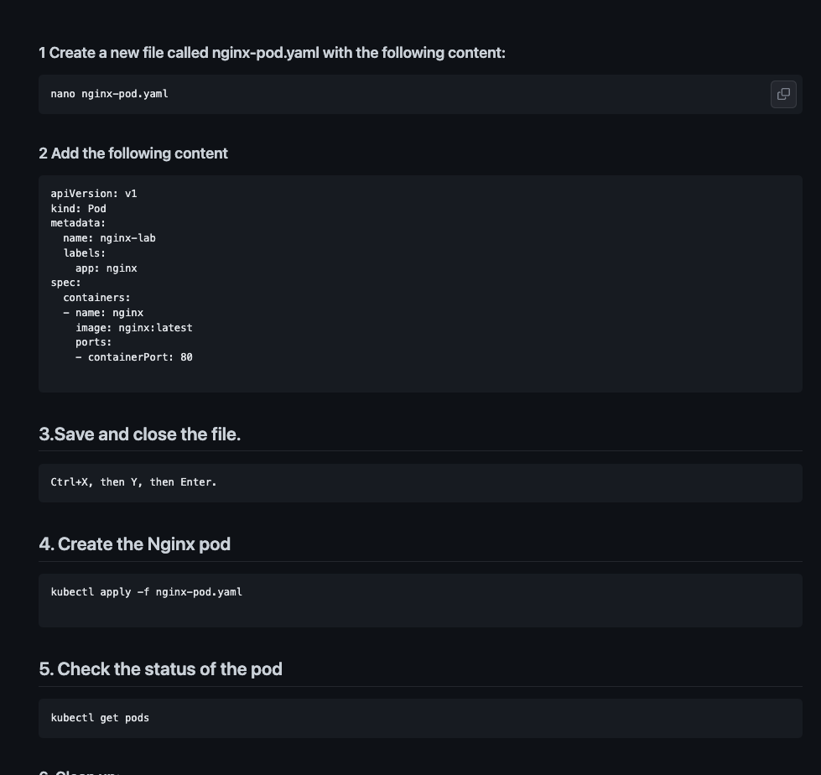
LAB Pod
https://github.com/it63070105/SOFTWARE-DEVELOPMENT-TOOLS-AND-ENVIRONMENTS/tree/main/Week11/Pod

Slide 31
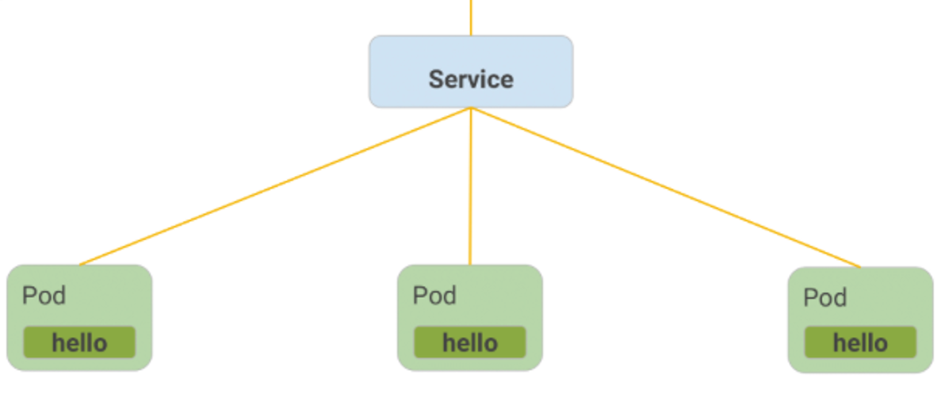
Service
In Kubernetes, there are generally three types of services
NodePort: This service type allows the pods to be accessed from outside the cluster via a static port on each worker node. This is often used for development and testing purposes, but not recommended for production use as it can pose security risks.
ClusterIP: This is the default service type in Kubernetes. It provides a stable IP address and DNS name to access a set of pods within the same Kubernetes cluster. This type of service is used for internal communication between components within the cluster.
LoadBalancer: This service type is used to expose pods to the internet or other external networks by creating a load balancer in a public cloud provider, such as AWS or GCP. It provides a single entry point for traffic to reach the pods and distributes the traffic across multiple nodes.

Slide 32
Node Pod

Slide 33
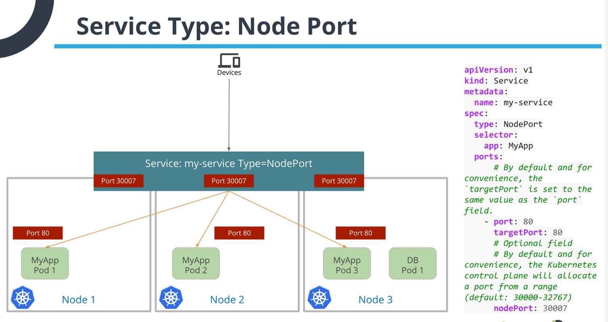

Slide 34
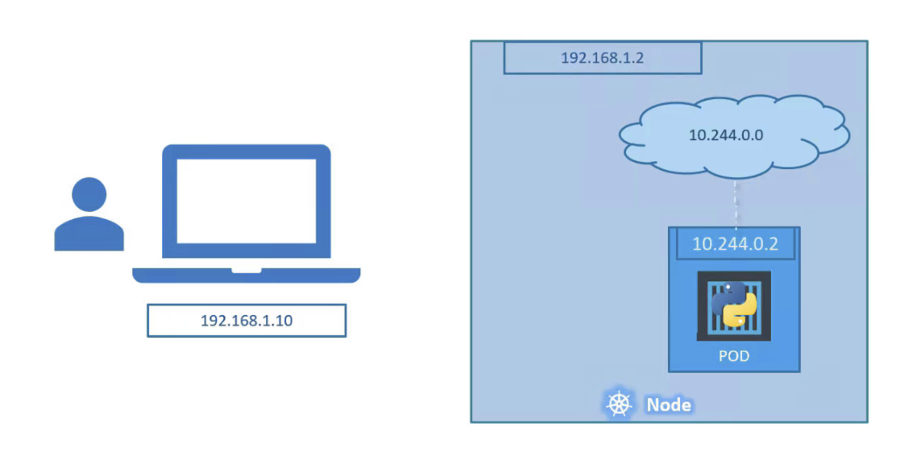

Slide 35
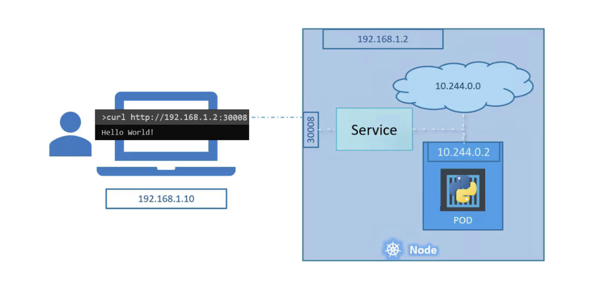

Slide 36
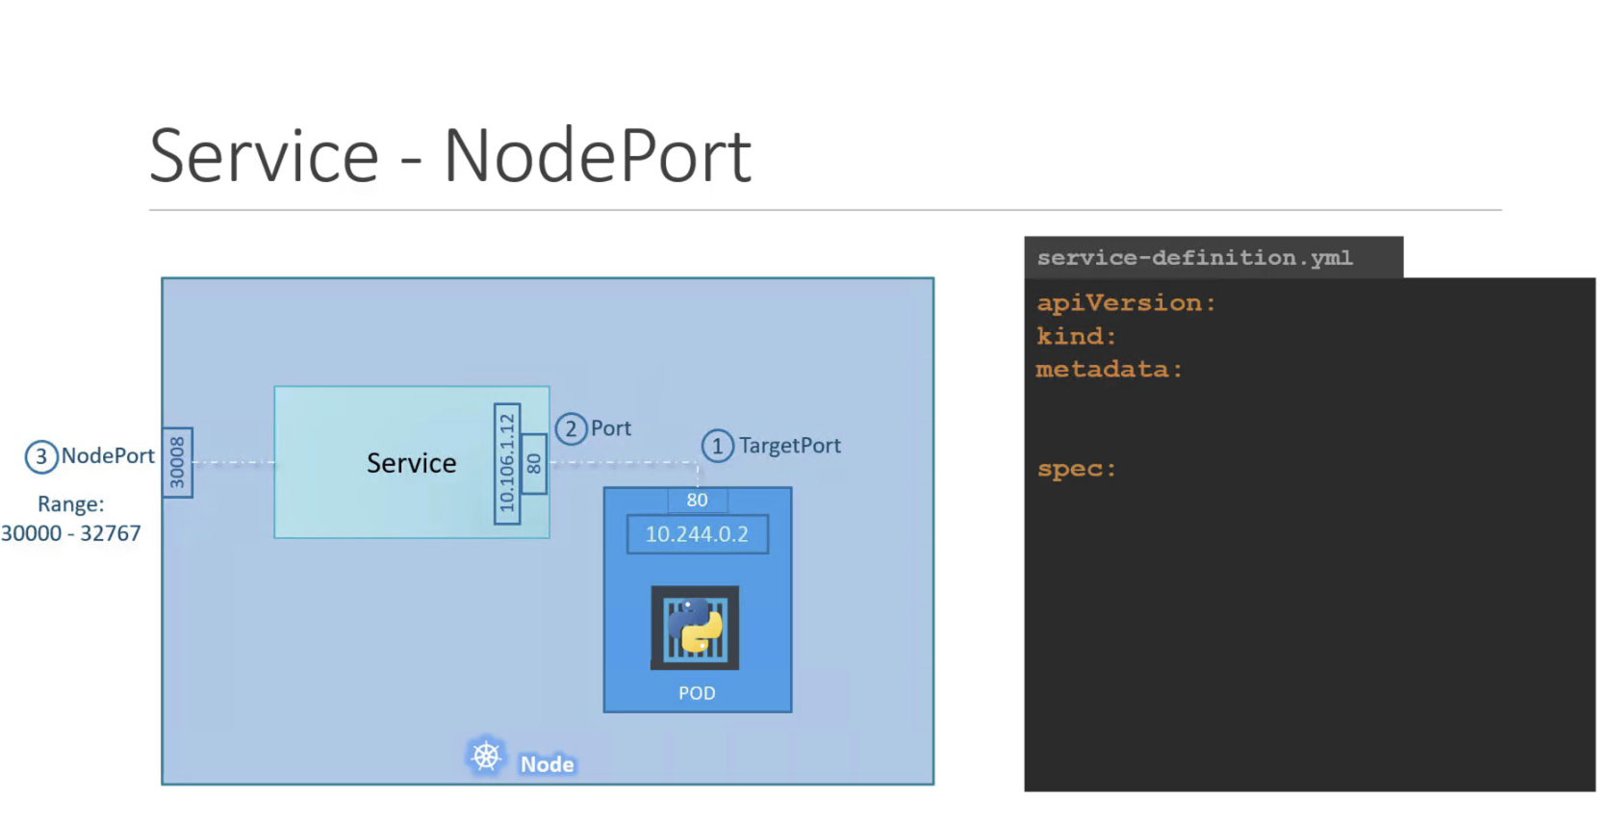

Slide 37
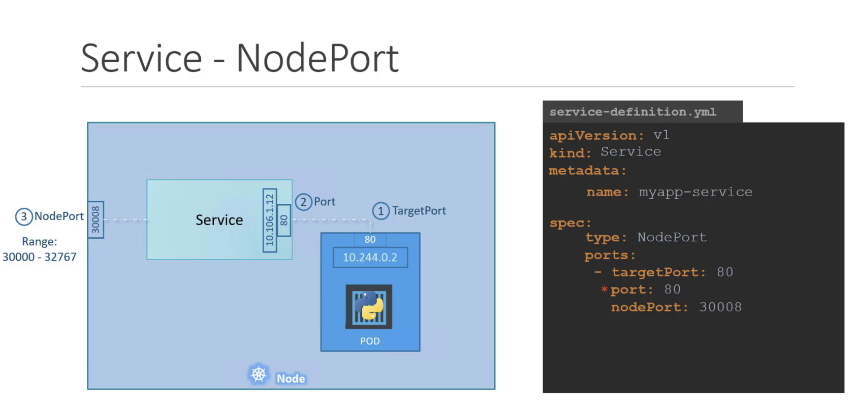

Slide 38
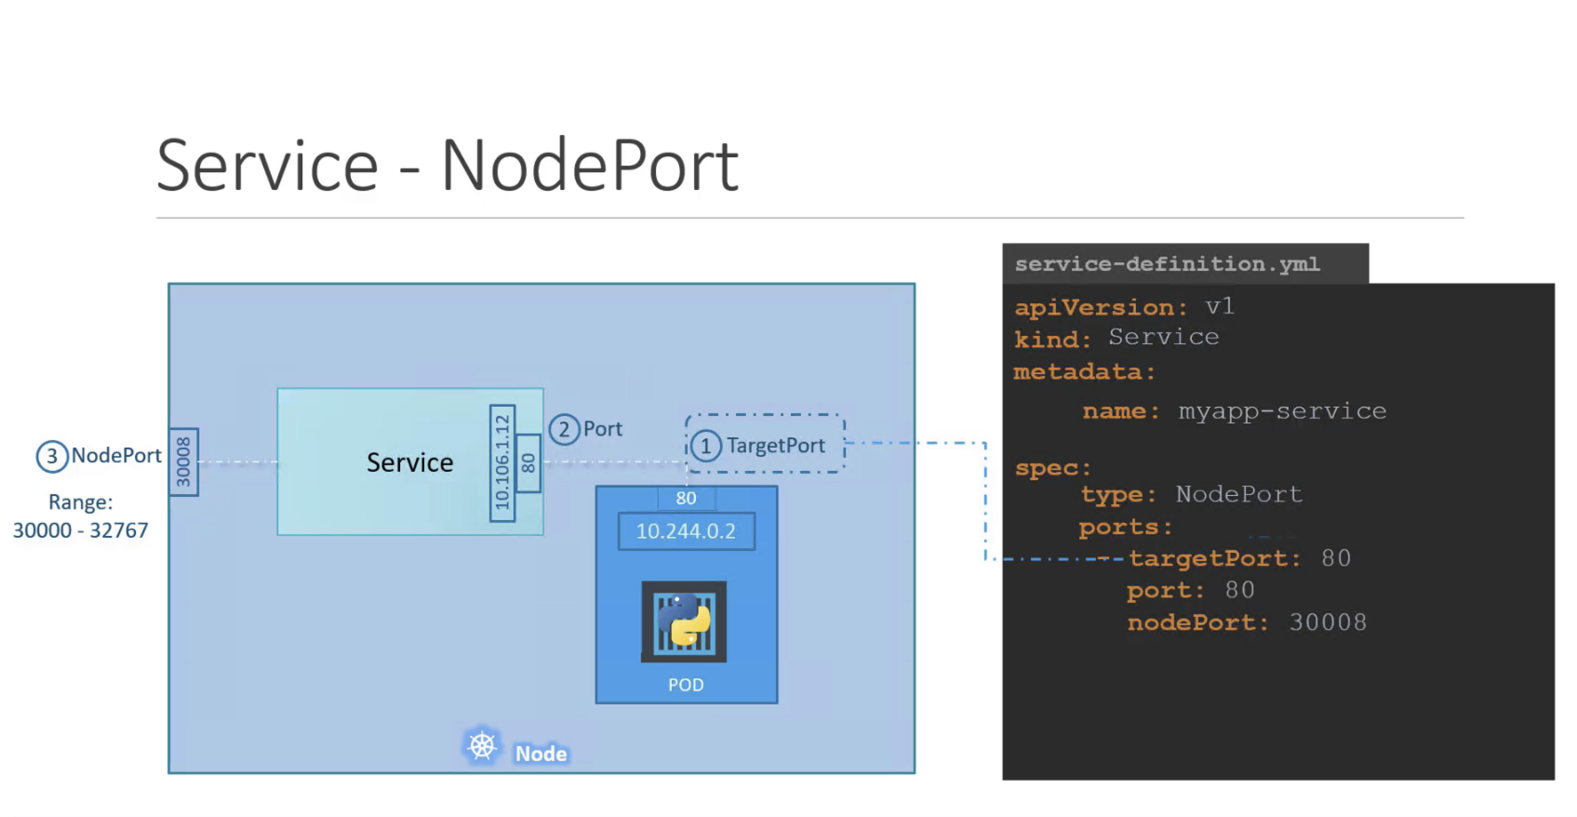

Slide 39
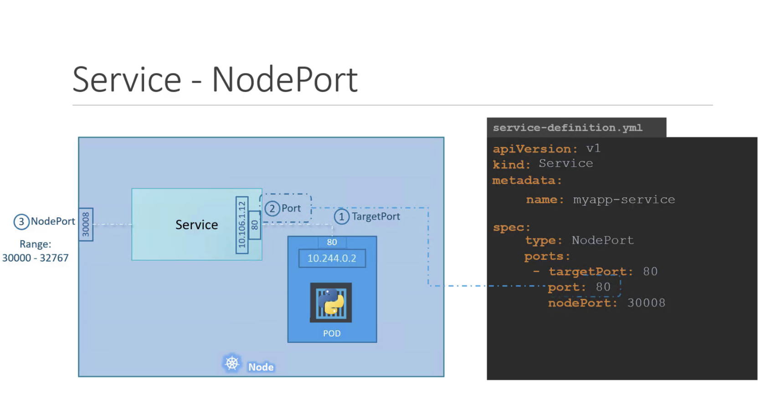

Slide 40
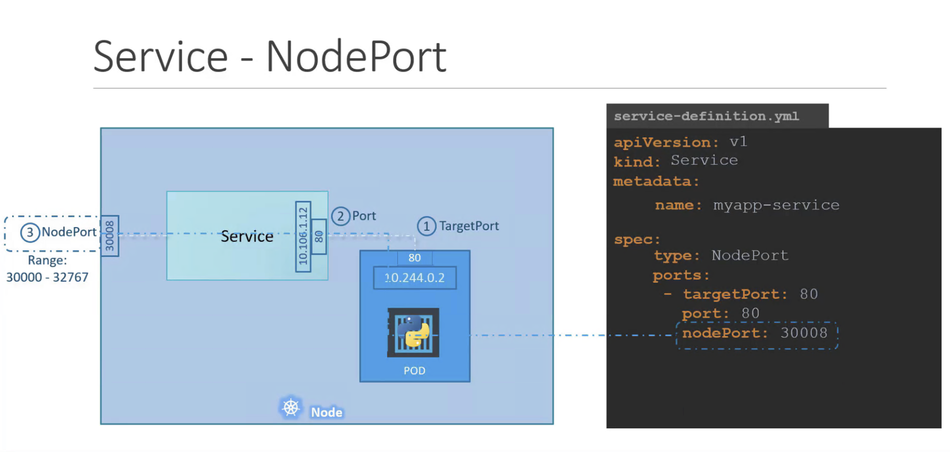

Slide 41
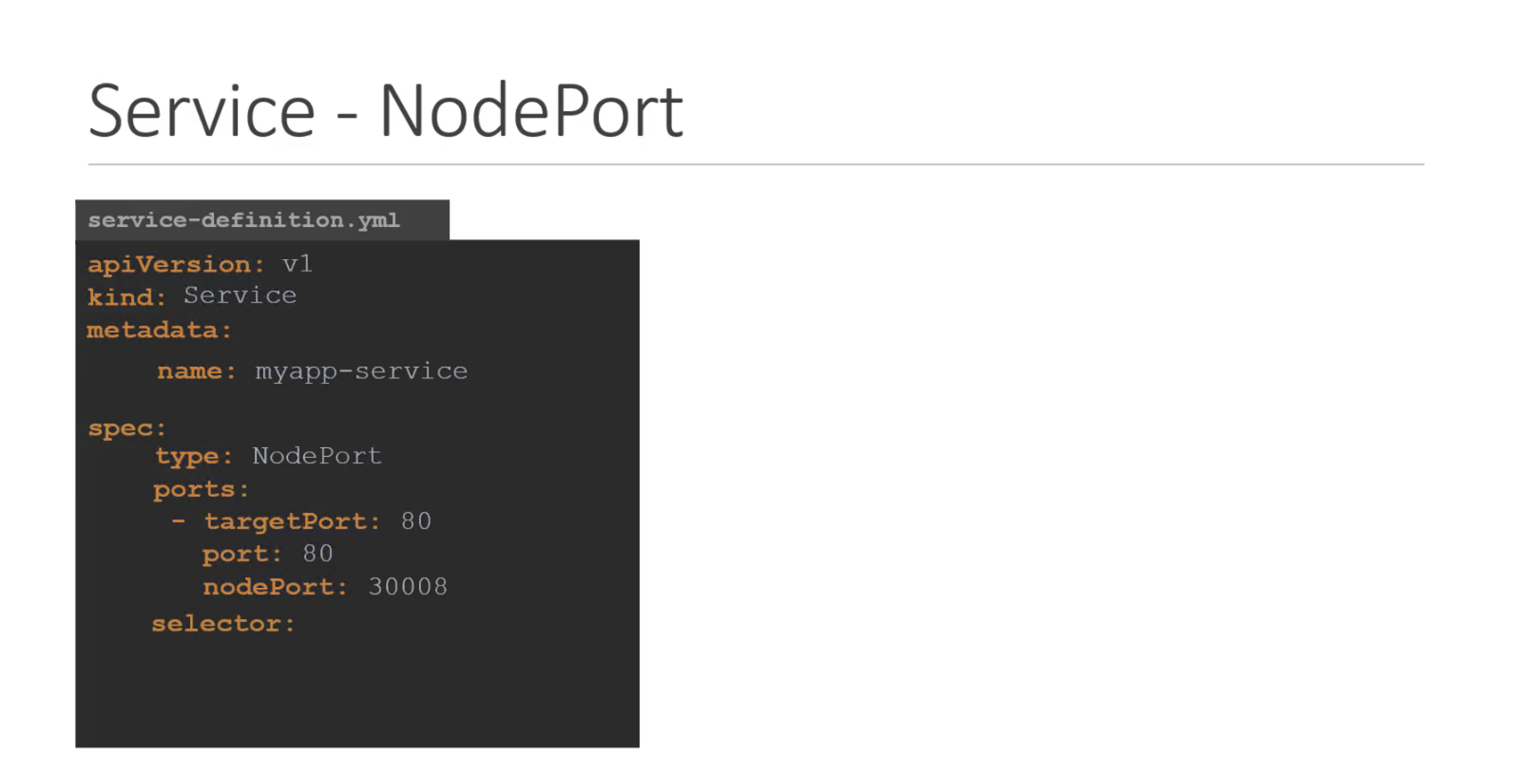

Slide 42
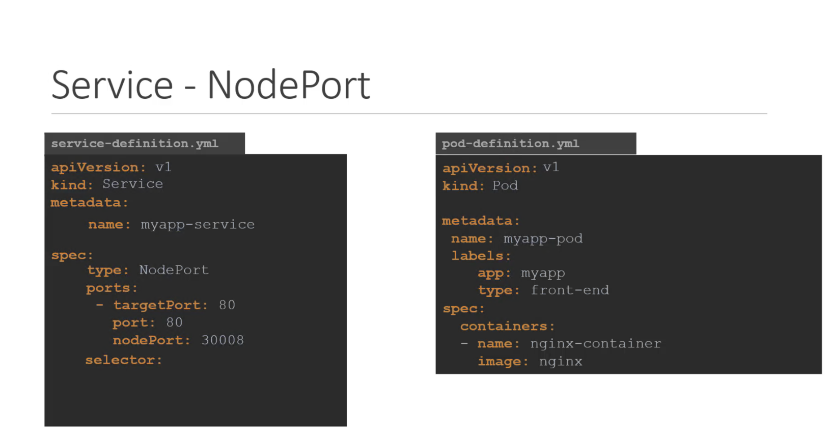



Slide 43
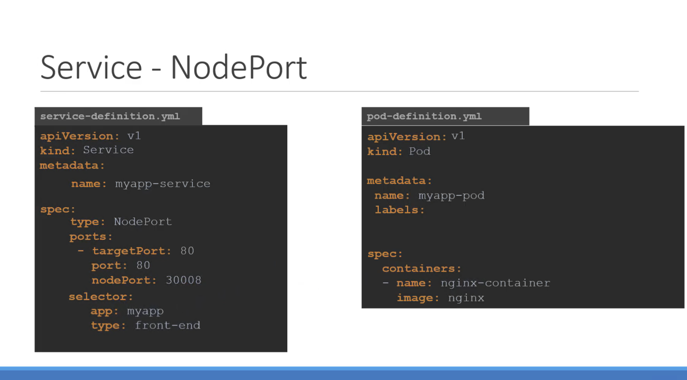


Slide 44
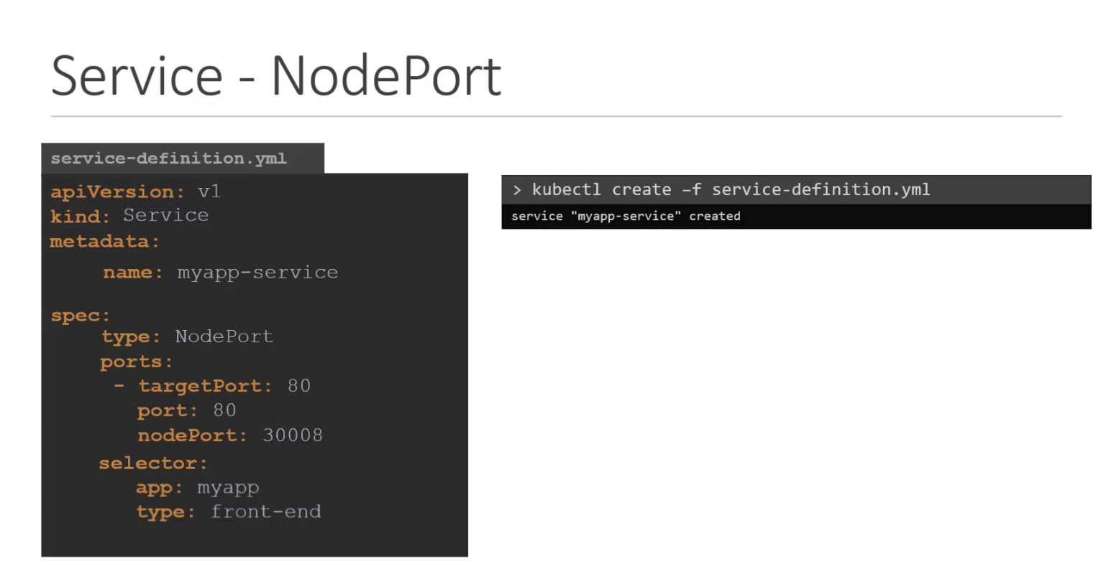

Slide 45
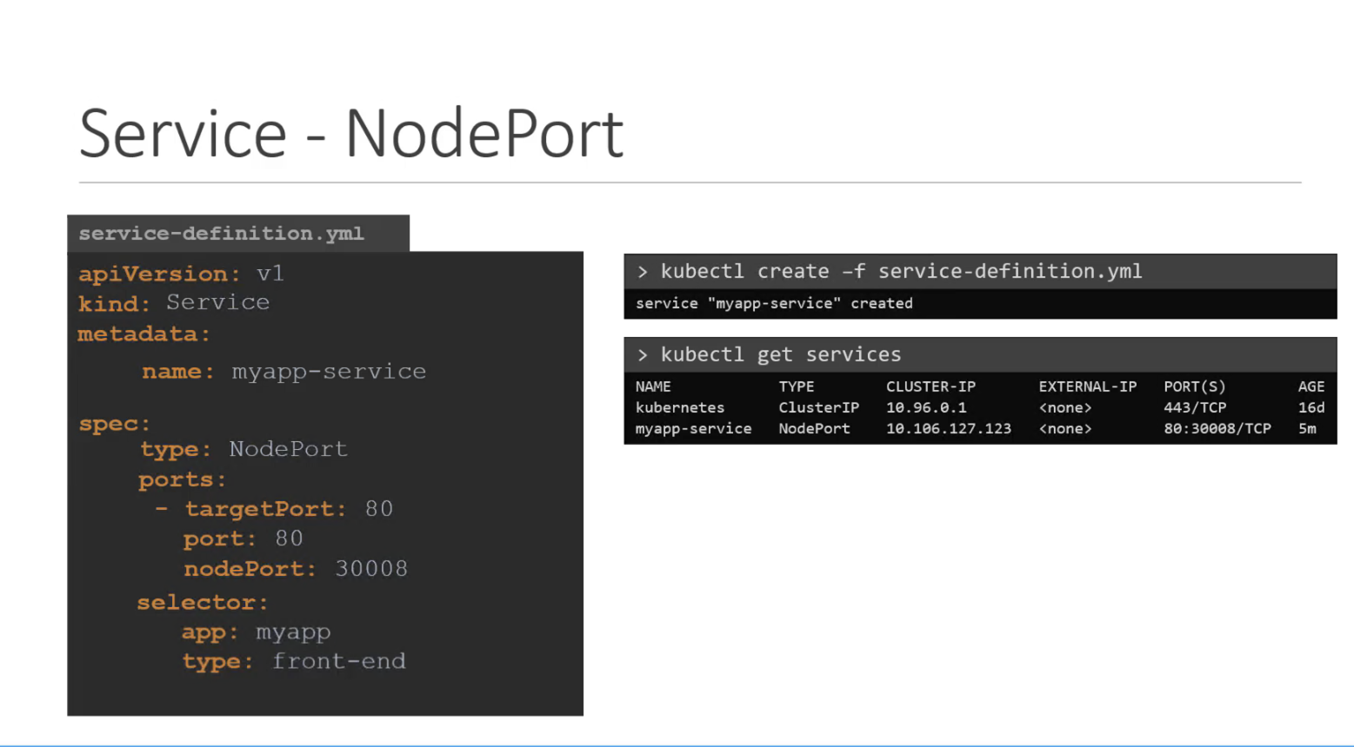

Slide 46
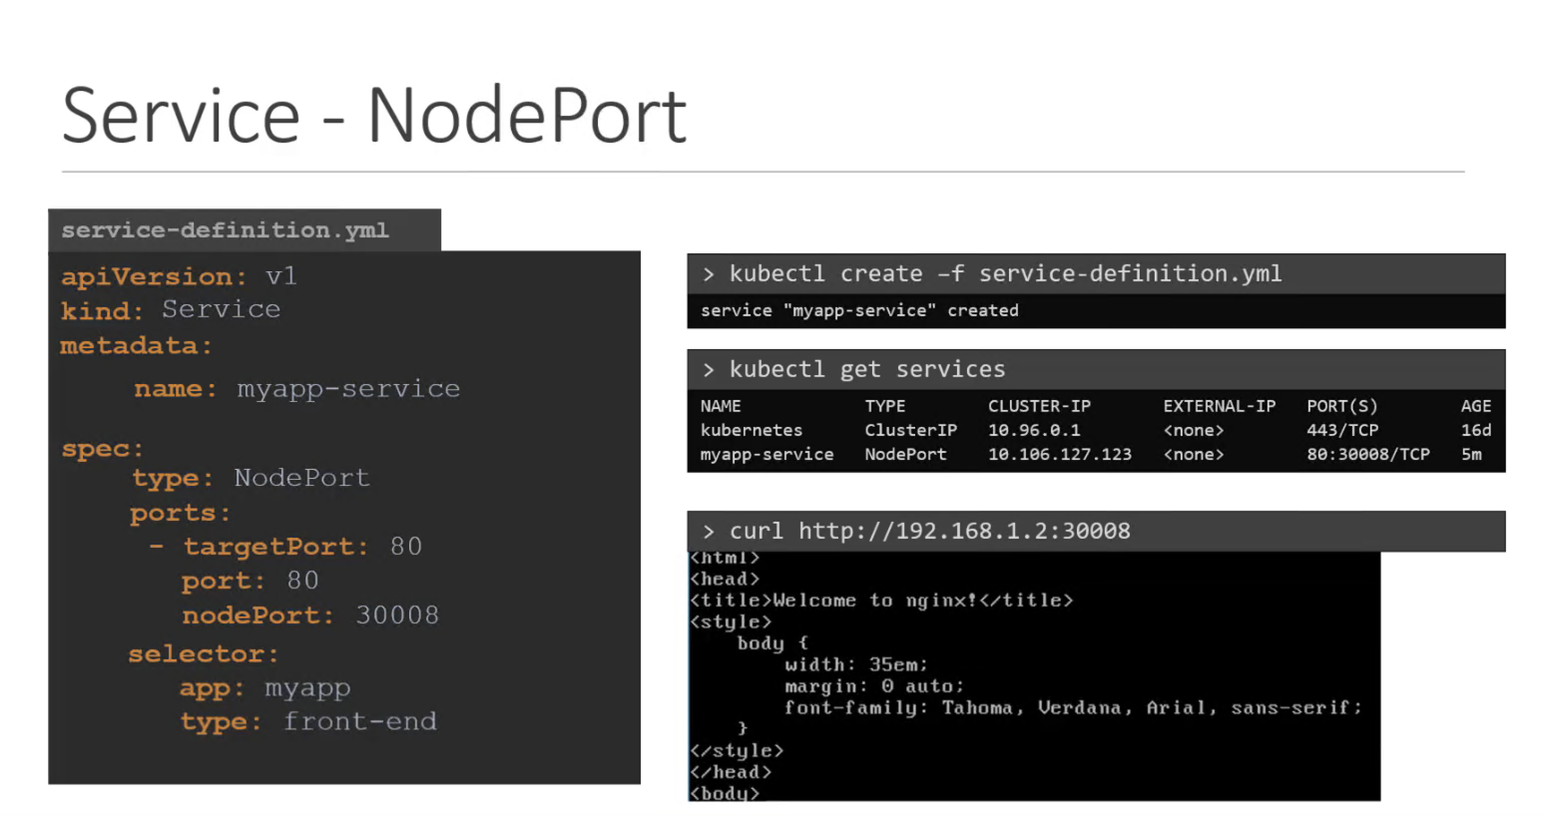

Slide 47
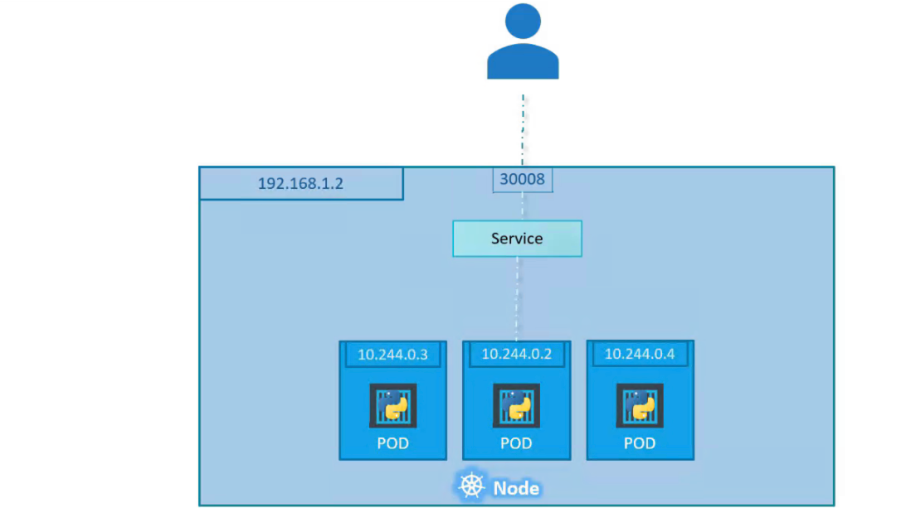

Slide 48
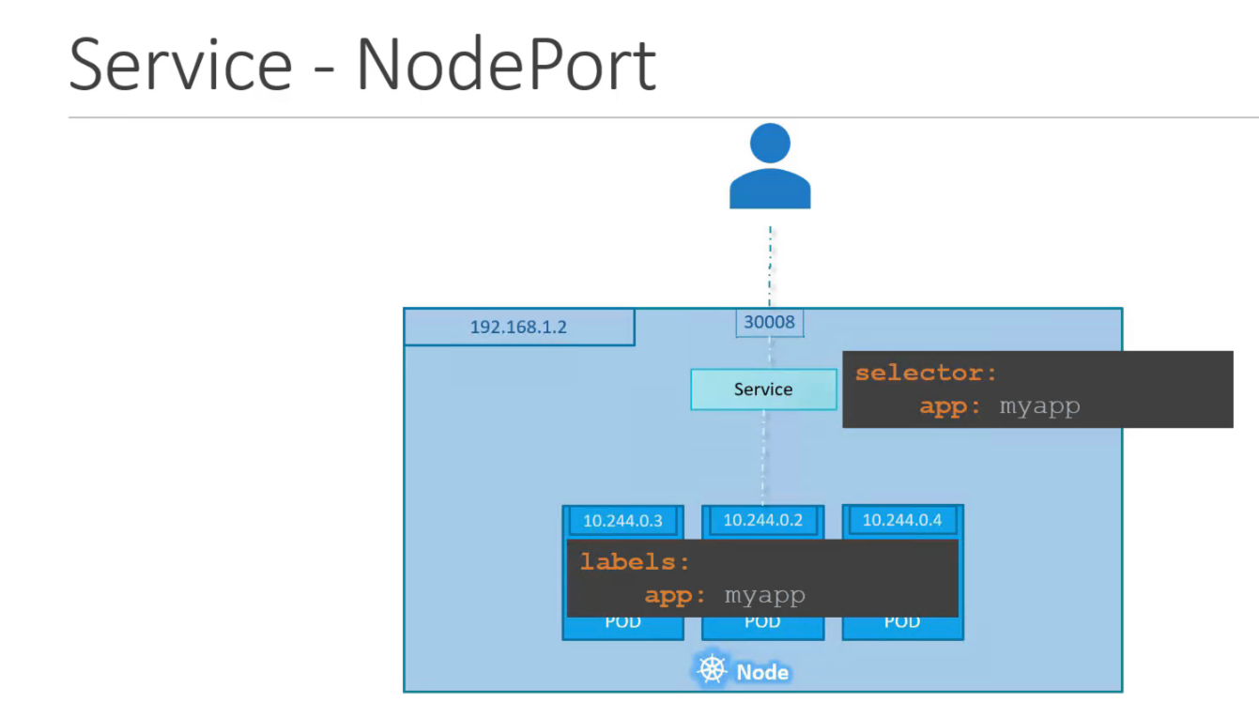

Slide 49
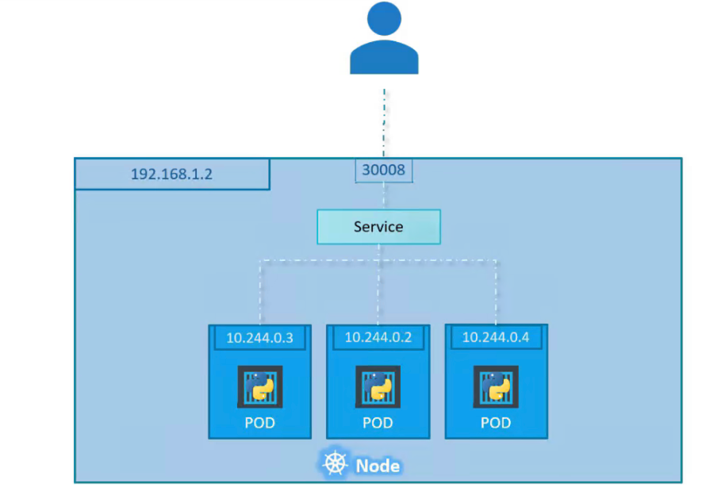

Slide 50
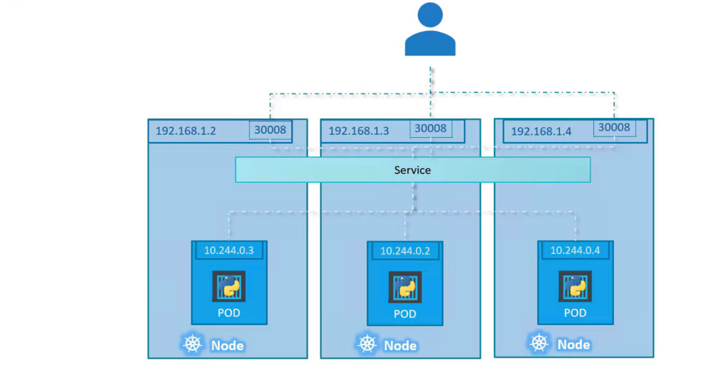

Slide 51
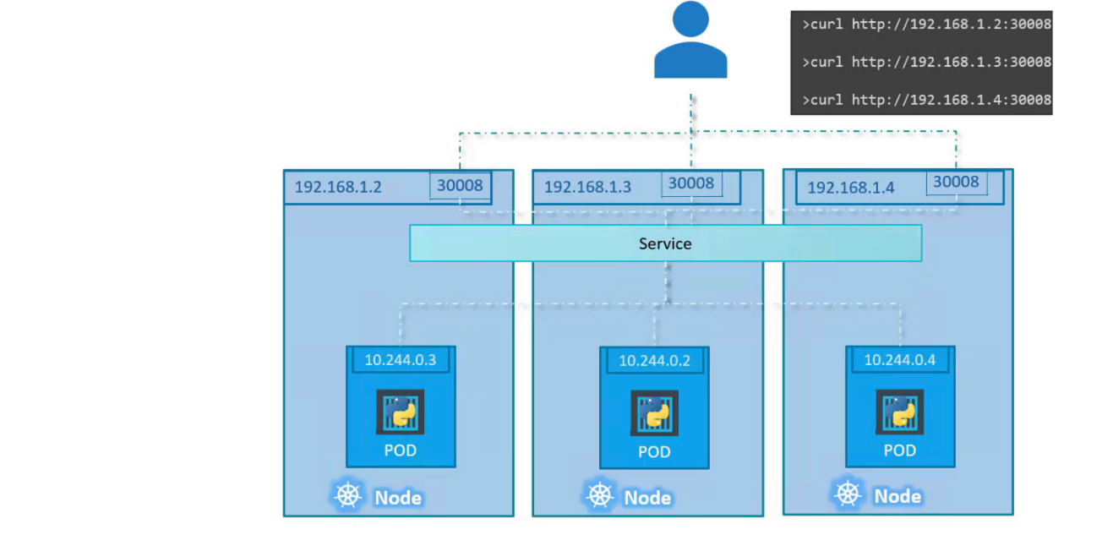

Slide 52
ClusterIP

Slide 53
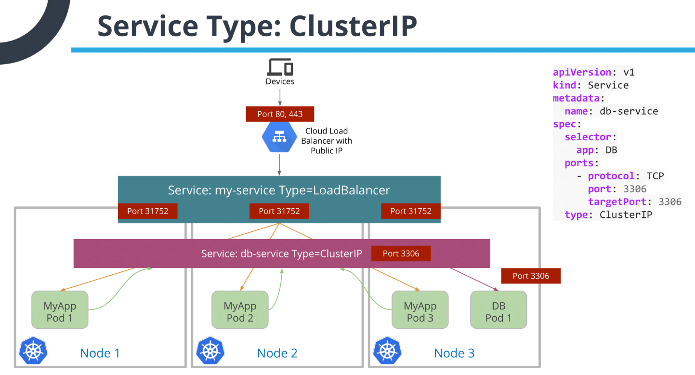

Slide 54
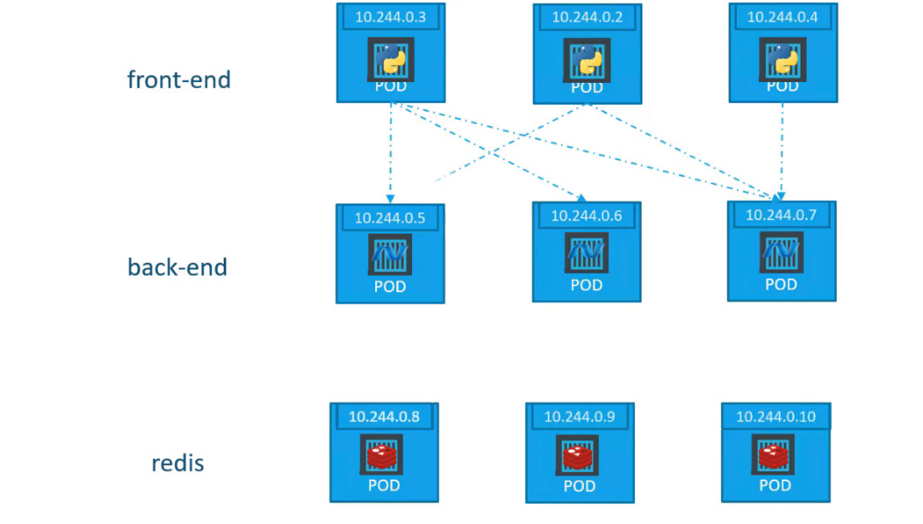

Slide 55
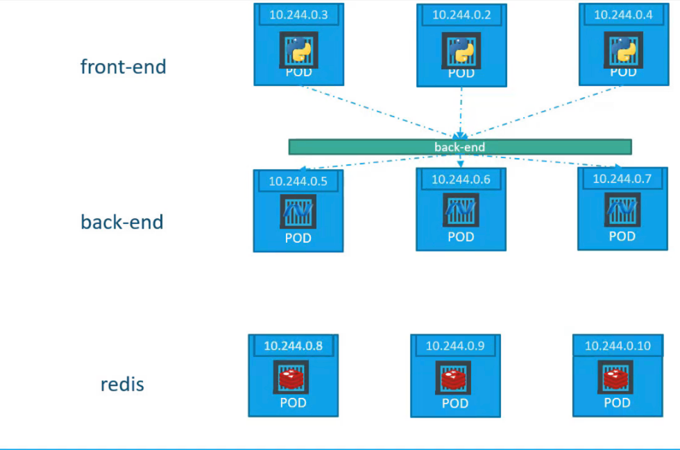

Slide 56
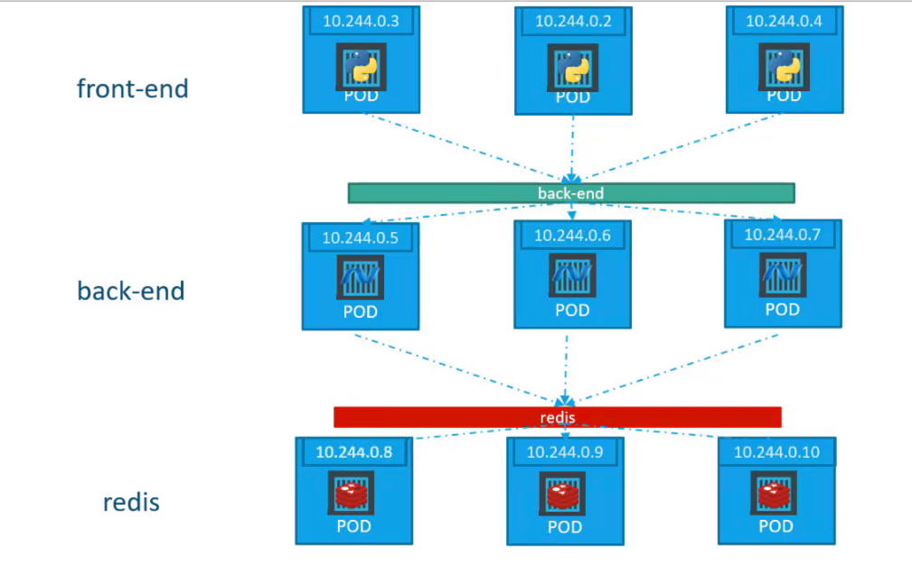

Slide 57
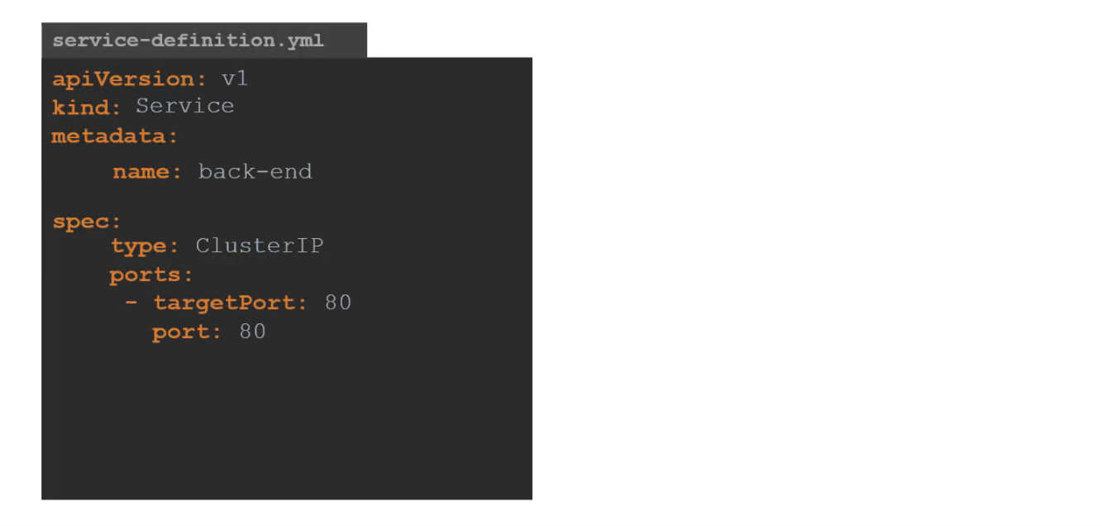

Slide 58


Slide 59


Slide 60
LoadBalancer

Slide 61


Slide 65


Slide 66


Slide 67


Slide 68


Slide 69


Slide 70


Slide 71


Slide 72


Slide 73


Slide 74


Slide 75


Slide 76


Slide 77


Slide 78


Slide 79


